Slide 1
CS 4476/7646 Project 2
Wenyue Wang
wenyue_wang@gatech.edu
903204153

Slide 2
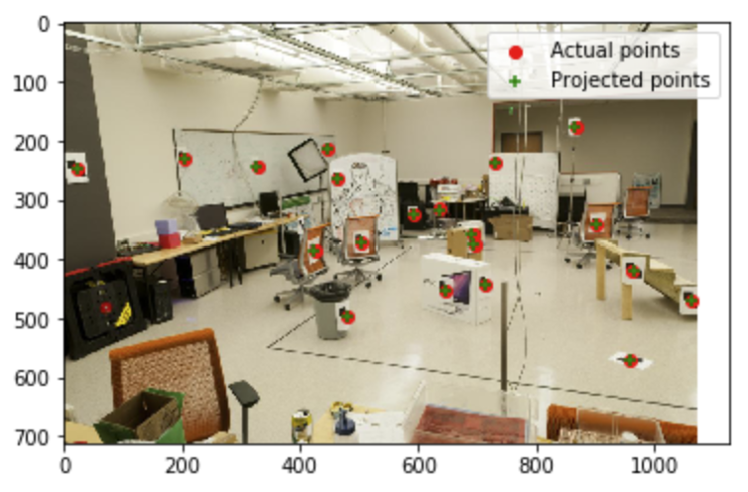
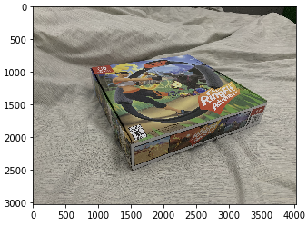
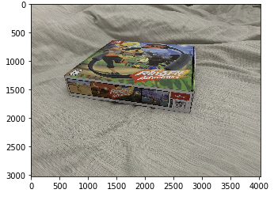
Part 1: Projection Matrix
<insert visualization of projected 3D points and actual 2D points for image provided by us here>
< insert the two images of your fiducial object here>

Slide 3
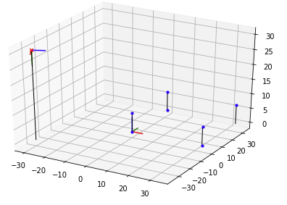
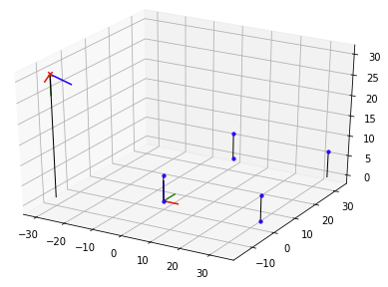
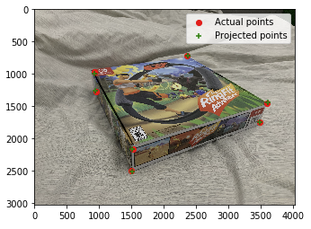
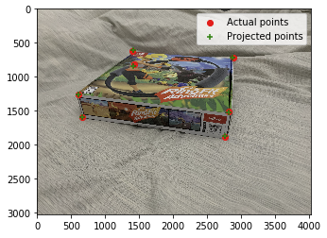
Part 1: Projection Matrix
<insert visualization the initial guesses for rotation matrix and camera center for the two images here>
<insert visualization of projected 3D points and actual 2D points for both the images you took>

Slide 4
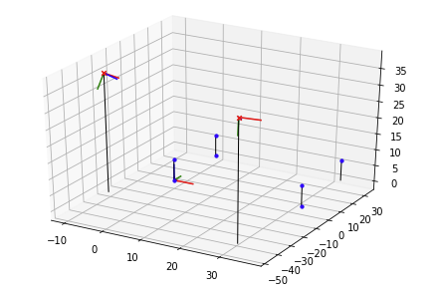
Part 1: Projection Matrix
<insert visualization of both camera poses here>

Slide 5
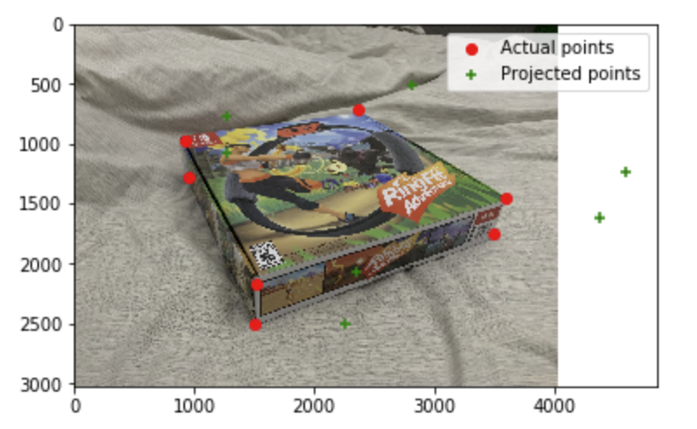
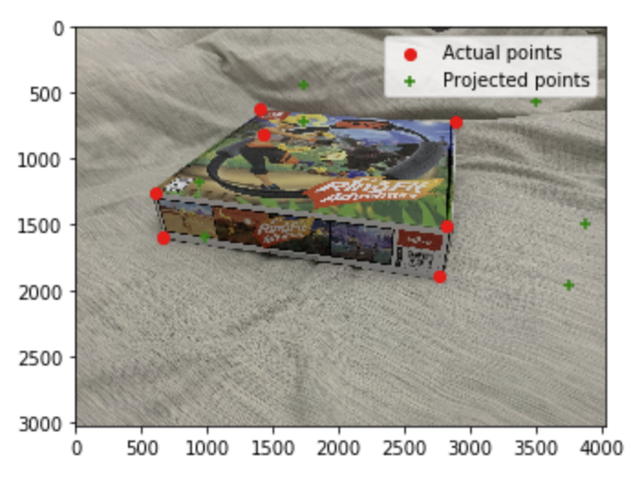
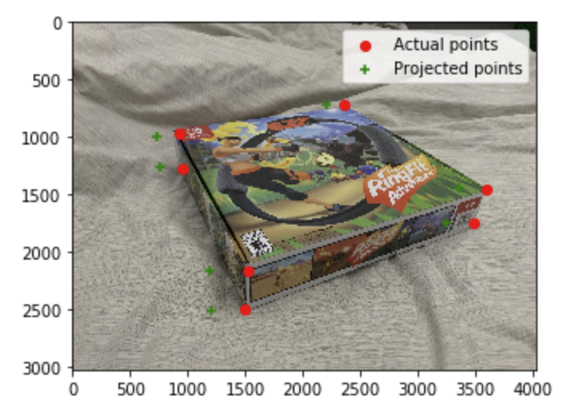

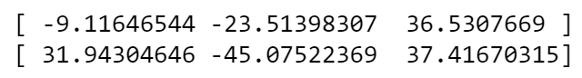
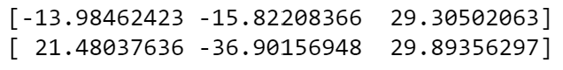
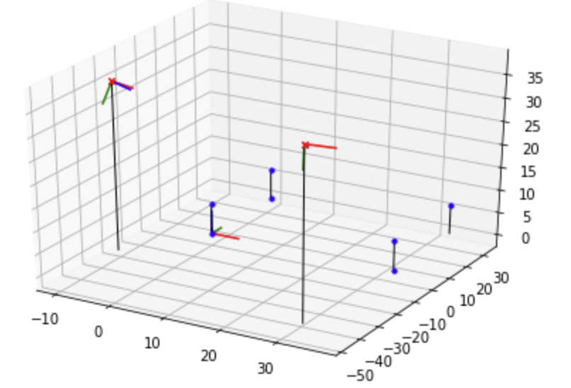
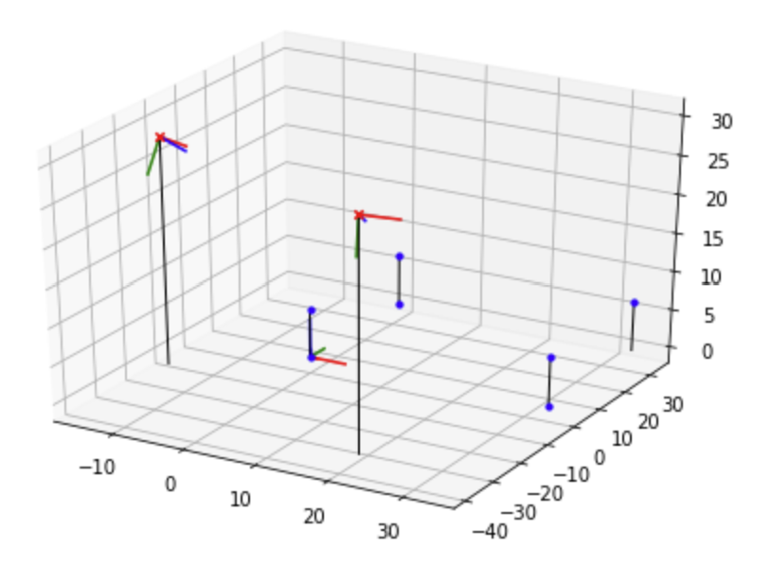
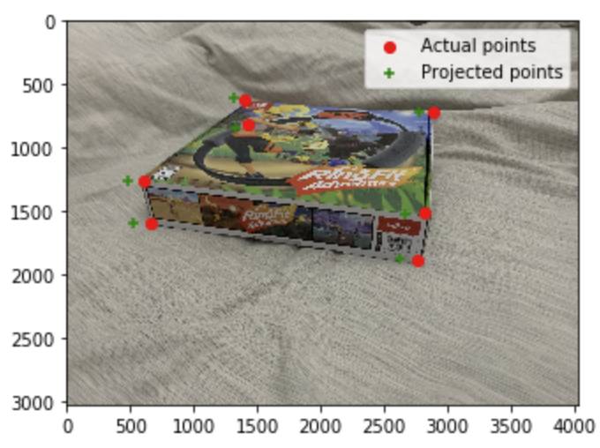
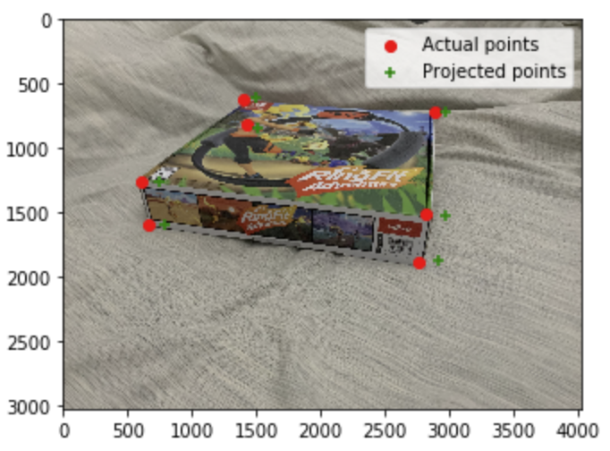
Part 1: Projection Matrix
For question 2, I enlarged the x axis, and shrink the y and z axes. The finalized results for projection points, and camera centers before and after changing P is as follows. As we can see, the position of camera center is following the same pattern as we change the axes.
Before performing the projection, I changed t_x, t_y and t_z from P1 and P2 separately. By shrinking it by 0.8 I expected to see the projected points shift to the origin a little on each axis. And by enlarging it by 1.2 I expected to see them shift away from the origin. Below is what the projection like after I multiple x axis by 0.8 and 1.2, respectively. And it does show what I expected.

Slide 6
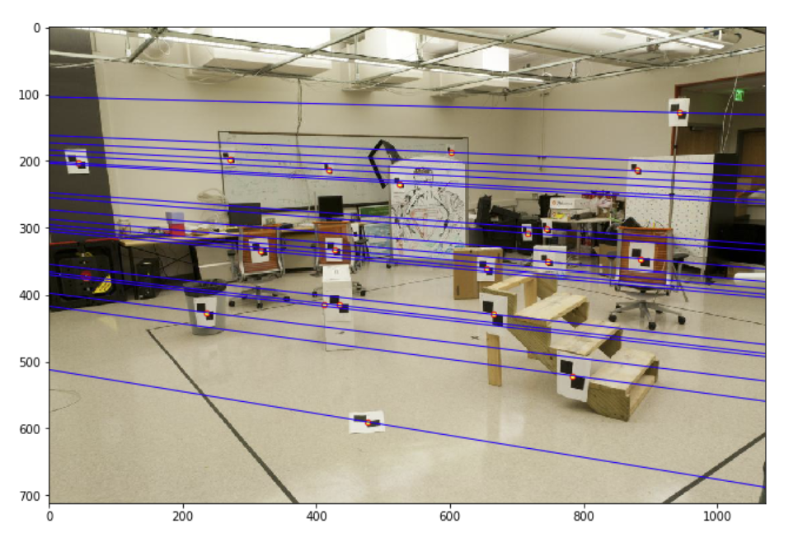
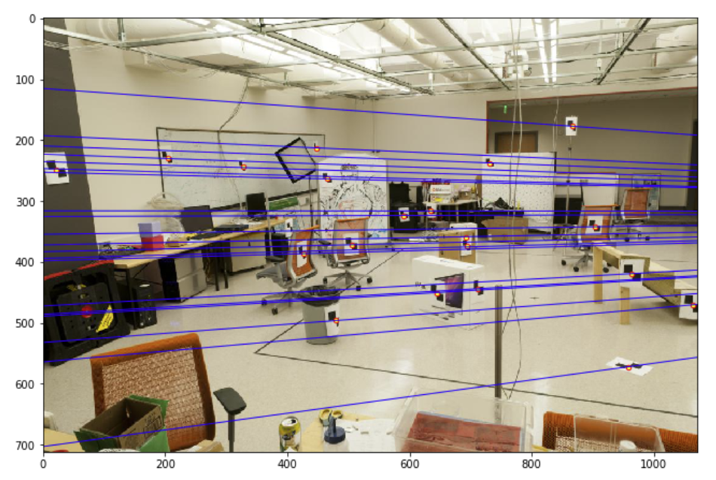
Part 2: Fundamental Matrix Estimation
Room: Left Image with Epipolar Lines
Room: Right Image with Epipolar Lines

Slide 7
Part 2: Fundamental Matrix Estimation
Fundamental Matrix Estimation Result:
[[ -0.00005608 0.00059327 -0.014601 ]
[ 0.00087223 -0.00015445 -2.39641427 ]
[ -0.22260075 1.74869963 57.12943309 ]]

Slide 8
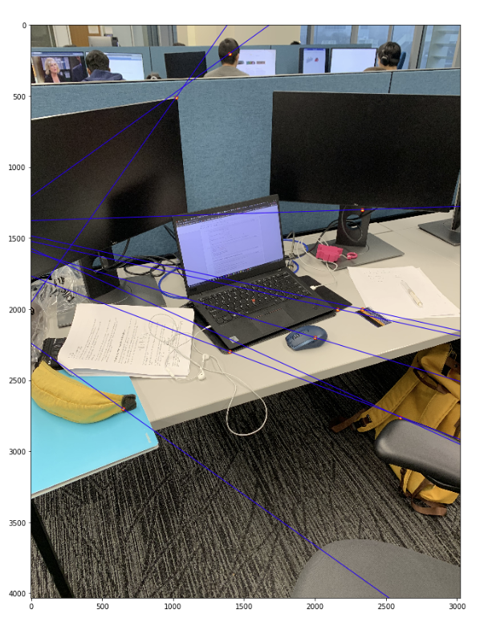
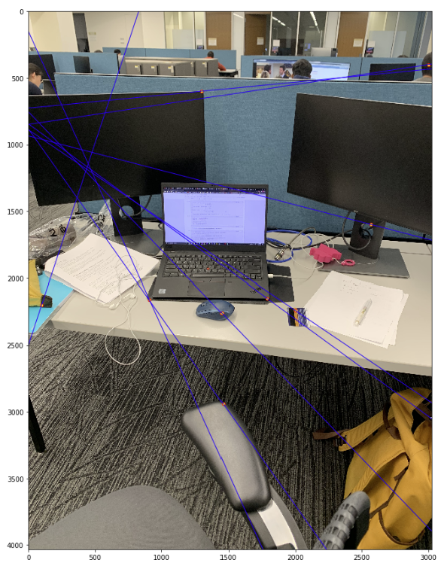
Part 2: Fundamental Matrix Estimation: Your Images
Your Image: Left Image with Epipolar Lines
Your Image: Right Image with Epipolar Lines

Slide 9
Part 2: Fundamental Matrix Estimation: Your Image
Fundamental Matrix Estimation Result:
[[ -0.00000181 0.00001281 -0.01698484 ]
[ -0.00001079 -0.00001262 0.01335842]
[ 0.00985009 0.01902202 -8.12341478 ]]

Slide 10
Part 2: Reflection Questions
1. Because the focal length of two images will be different
2. Because epipolar line is the line between epipolar and the projection of the point from the image
3. This will be similar as the forward motion case, where epipolar is the locus of the principal point of the camera, and epipolar lines go out from the principal point.
4. It means when taking these two photos, camera does not rotate but pure translation, so that two images are on the same plane
5. Because F is not unique, it varies based on camera and image positions
6. Because F is a 3*3 matrix, and 7 degrees of freedom. So it is singular with a rank of 2.

Slide 11
Part 2: Extra Credit: Fundamental Matrix Song
Reflect on the Fundamental Matrix Song
Link here: https://www.youtube.com/watch?v=DgGV3l82NTk
Fundamental matrix song uses a humor and interesting way to clearly explain fundamental matrix and its relevant concepts, like epipolar constraints, homogeneous design, SVD decomposition and rank deprivation. It helps me to connect all subsections of epipolar lines, and the hand-drawing style helps visualized how images formed.

Slide 12
Part 3: RANSAC Iterations Questions
Delete the questions and type your answers to the three RANSAC Iterations questions from the jupyter notebook below:
14 iterations
42 iterations.
167 iterations

Slide 13
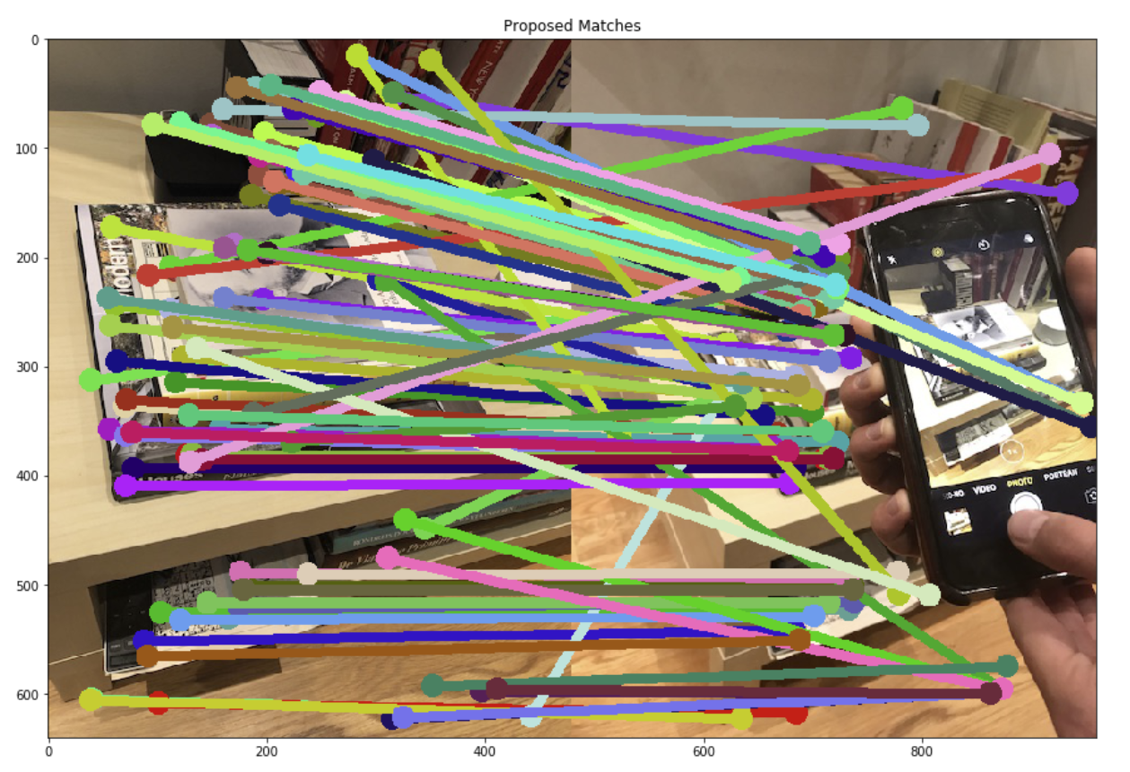
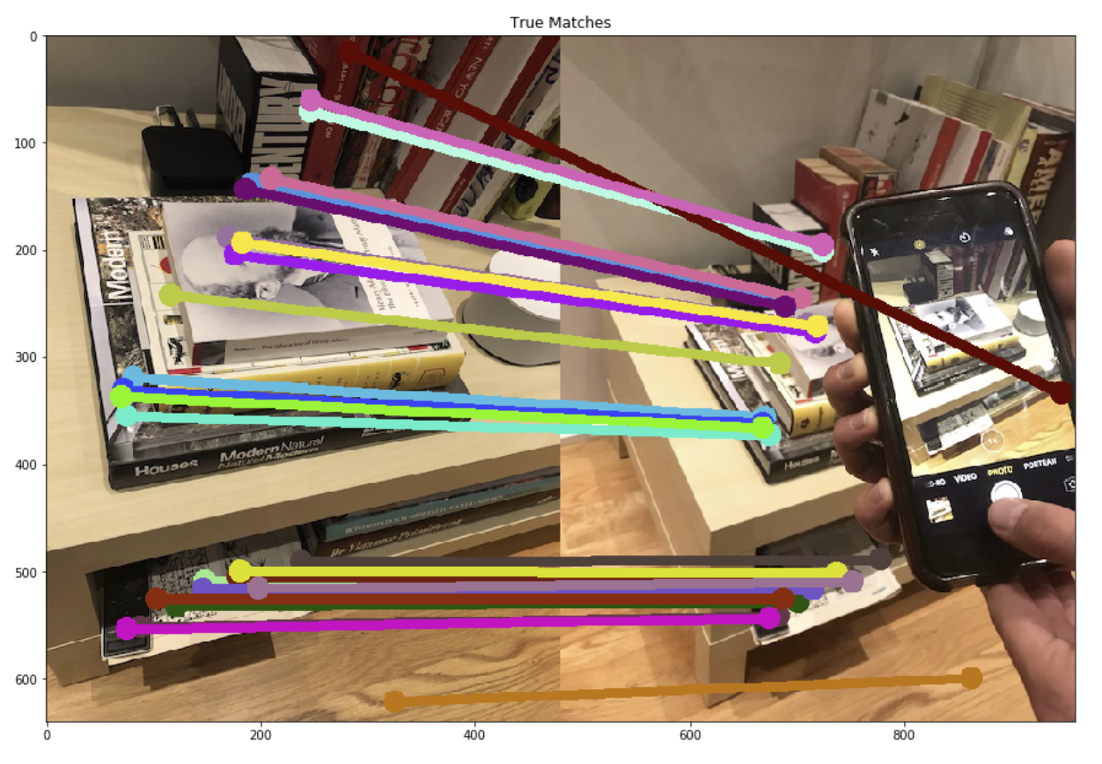
Part 3: RANSAC Inlier Matches
Paste two sets of images: displaying matches loaded from disk; and inlier matches after RANSAC

Slide 14
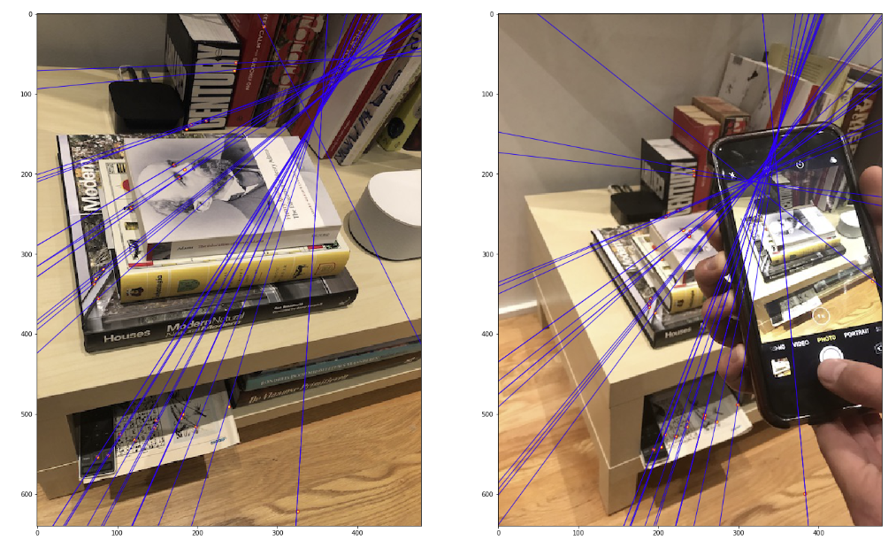
Part 3: RANSAC Implementation
Delete this and paste the results of the epipolar lines unit test that you wrote for your RANSAC implementation at the very end of the jupyter notebook. This should display the epipolar lines in two images showing where the other image was taken. (See the image pair at the top of the website for an example of what we are looking for). We should be able to see you and the intersect point where the other image was taken in at least one of the two pictures.

Slide 15
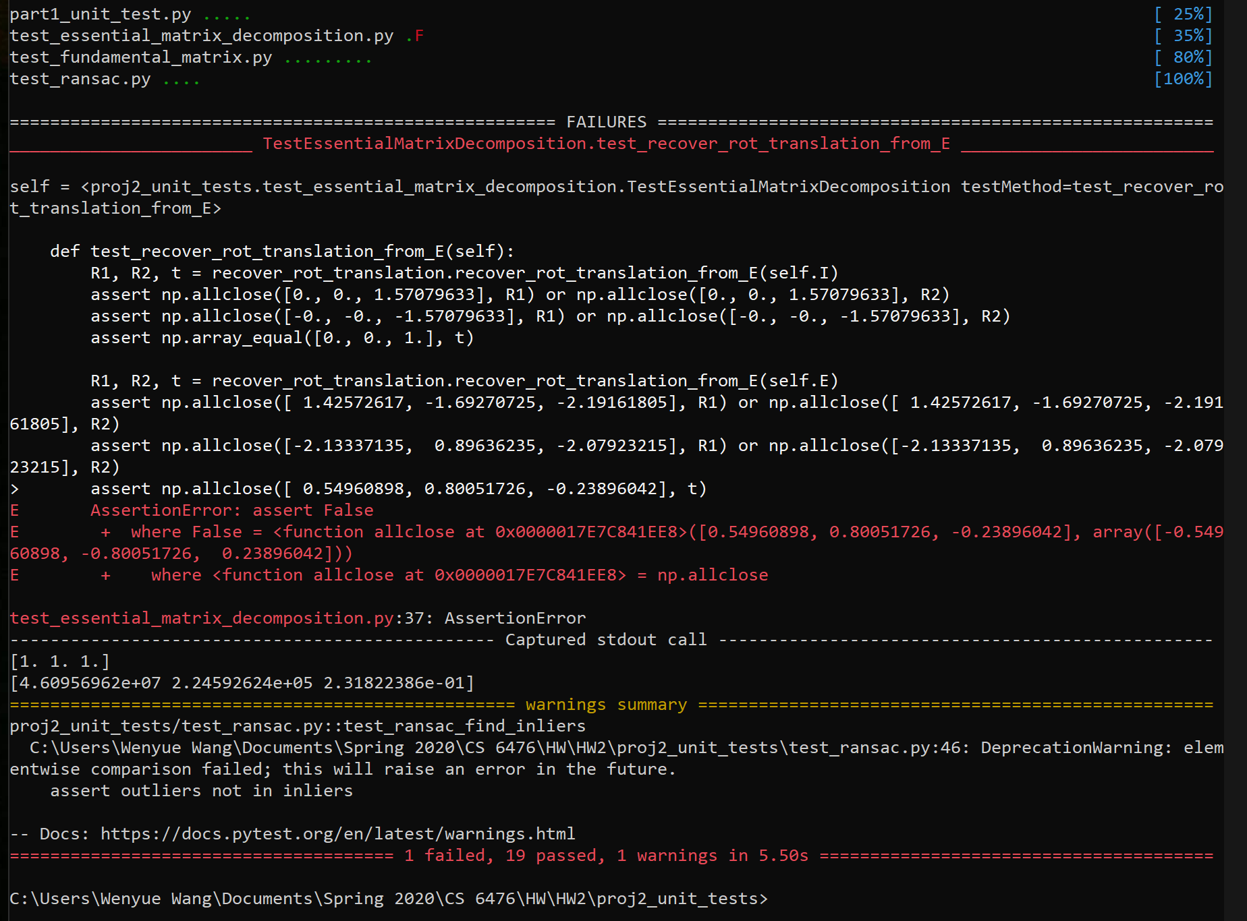
Tests

Slide 16
Conclusions
From this project, I understand how epipolar geometry works and how RANSAC be applied. The visualization on the given example, and the rying out based on our own images extremely helps me to understand these concepts. The overall difficulty is reasonable, since Piazza do provides lots of hints and explanations.

